Slide 1
ICTSAS519 – Task 2
Author: Alessandro Ferro

Slide 2
1.1 Determine acceptance criteria from system specification
Clicking ‘New Customer’ open Add new customer page on the right side
If address field contain special characters the used is prompted to modify it.
If the pin chosen by the user is shorter than six digit the user is prompted to make it six digit long
If the email field doesn’t contain a ‘@’ and a ‘.’ the user is prompted to enter a valid email.
Leaving blank fields and clicking ‘Submit’ alert the user to fill all the fields
If all the values are entered correctly, a review page will appear on the right side with the new customer details. A new ID is assigned to the customer.

Slide 3
Clicking ‘Edit Customer’ open the Enter ID page on the right side.
Clicking ‘Submit’ without filling the Customer ID field prompt the user to insert an ID.
Entering the wrong ID prompt the user to enter a valid ID.
Entering a valid ID open the editable customer detail page on the right side.
The fields ‘Customer Name’, ‘Gender’ and ‘Date of Birth’ are read only and therefore cannot be edited.
Leaving a blank field prompt the user to fill up every field.
If no changes are made, the system will alert the user and will redirect him to the Enter ID page.
If the changes are valid the detail page will open up with a success message.
Clicking ‘Delete Customer’ open the Delete Customer page on the right side.
Clicking ‘Submit’ with a blank ID field will prompt the user to enter an ID.
Entering the wrong ID will alert the customer and will redirect to the ‘Enter ID’ page.

Slide 4
Clicking ‘Submit’ on the Delete customer page with a valid ID entered will alert the customer of the success of the operation.
Trying to edit the deleted customer will confirm that the customer doesn’t exist.
Clicking ‘New Account’ will open the new account form on the right side.
Leaving blank fields and clicking ‘Submit’ will prompt the user to fill every field.
Entering the wrong ID and clicking ‘Submit’ will alert the user and clear every field.
Entering an ‘Initial Deposit’ lower than 500 will prompt the user to enter at least 500.
Entering a valid ID and a valid deposit will redirect the customer to the account details page with a ‘Success’ message and an account ID will be assigned.
Clicking ‘Edit Account’ will open the edit account form on the right side to enter the ID of the account to modify.
Entering the wrong ID will alert the user and will redirect to the Edit Account Form.

Slide 5
Entering a valid ID will redirect the user to the Edit Account Form.
Customer ID and Balance will be Read only field and therefore cannot be modified.
Clicking ‘Submit’ without any change will alert the user and will redirect to the Edit account form to enter a new ID.
Updating the type of account will redirect the user to the account details page with a ‘success’ message and the modified details of the account.
Clicking ‘Delete Account’ will open the Delete Account Form on the right side of the page.
Leaving blank fields and clicking submit will prompt the user to enter an ID.
Entering an invalid ID will alert the user and will redirect to the Delete account Form with the fields cleared.
Entering a valid ID will alert the user of the success of the operation and will redirect the user to the Manager Page.
Trying to edit the deleted account will result in a “Account doesn’t exist” message.
Clicking ‘Deposit’ will open the Deposit Form page on the right side of the screen.

Slide 6
Description box will accept no more than 10 characters (including blank)
Leaving blank fields will prompt the user to fill in all the fields.
Filling in all the fields and clicking submit will open a review page with the details of the transaction and the new total amount on the account.
WARNING – Entering a negative amount in the amount field will prompt the user to enter a valid amount.
Entering letters in the amount field will prompt the user to enter numeric values.
Entering an invalid account will alert the user of the mistake and will reset the form fields.
Clicking ‘Withdrawal’ will open the withdrawal form page on the right side. Of the screen.
Description box will accept no more than 10 characters (including blank)
Filling in all the fields and clicking submit will open a review page with the details of the transaction and the new total amount on the account.
Leaving blank fields will prompt the user to fill in all the fields.
Trying to withdrawal more than what is available on the account will alert the user that the account is too low.

Slide 7
WARNING – Entering a negative amount in the amount field will prompt the user to enter a valid amount.
Entering letters in the amount field will prompt the user to enter numeric values.
Entering an invalid account will alert the user of the mistake and will reset the form fields.
Clicking ‘Fund Transfer’ will open the Fund Transfer form page on the right side of the screen.
Entering invalid characters or leaving the fields blank will prompt the user to correct the wrong action.
WARNING – Entering a negative amount in the amount field will prompt the user to enter a valid amount.
Filling in all the fields with valid values and clicking submit will open the Fund Transfer Details page.
Clicking ‘Change Password’ will open the change password form on the right side.
Leaving blank fields will prompt the user to fill in all the fields.

Slide 8
The user will be prompted to chose a password that contain a numeric value and a special character.
Entering a wrong password in the ‘Old Password’ field will alert the user and reset the fields in the form.
If the New Password field and the Confirm password field don’t match the user will be alerted.
If the fields are completed with valid values and the ‘New Password’ and ‘Confirm Password’ match, the user will be alerted of the success and will be redirected to the login page.
The new login credential will grant access to the admin page.
Clicking Balance Enquiry will open the Balance Enquiry Form on the right hand side of the screen.
Leaving the Account No field blank will alert the user to fill in the field.
Entering a wrong account number will alert the user and will reset the form.
Entering the right account number will display the Account details.

Slide 9
Clicking Mini Statement will open the mini statement form page on the right hand side of the screen.
Leaving the Account No field blank will alert the user to fill in the field.
Entering a wrong account number will alert the user and will reset the form.
Entering a valid account number will display a table with the last five transaction for that account.
Clicking Customized Statement will display the Customized Statement Form page on the right hand side of the screen.
Leaving Account No, From Date and To Date fields blank will prompt the user to fill in those fields.
Entering the wrong account number will alert the user that the account doesn’t exist.
Entering valid values in the Account No, From Date, and To Date fields, but leaving the Minimum Transaction Value and the Number of Transaction fields empty, will show all the transaction of that day.

Slide 10
Minimum Transaction Value and Number of Transaction fields, will filter the results accordingly.
If no statement can be found for the dates and the conditions specified, the user will be alerted and the form will reset.
Clicking Log Out will alert the user and will redirect to the Login form.

Slide 11
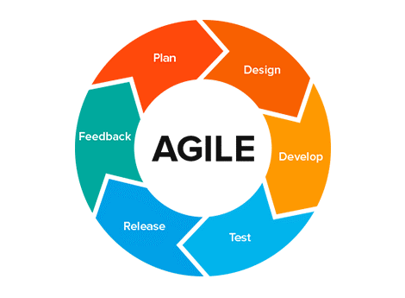
1.2 Determine and document software life cycle according to system specifications and contact in operations
The website is heavily focused on functionalities and many of these functionalities depend on other functionalities to work.
This kind of system can easily be prone to bugs and mistakes. Testing should be considered for the implementation of each new functionality.
The client is tech savvy and can guarantee valuable input throughout all development.
Even considering that most of the functionalities have already been identified, changes to the original plan can be expected.
For all this reasons an Agile approach would best suit the project.
Network administrator will need to be notified before every test cycle.

Slide 12
1.3 Define test plan from acceptance criteria, software life cycle, system specifications and in compliance with organisational testing and acceptance processes
TEST COVERAGE
The website functionalities will be tested using a combination of valid and invalid data (which can include blank values).
Minor security tests will be conducted (SQL Injection)
Check for broken links.
The website will be checked for responsiveness.
The website will be checked for cross-browser compatibility.
The website html will be checked against the standards set by W3C

Slide 13
TEST METHODS
W3C Link validation cannot be used. All links will therefore be checked manually.
Functionalities will be tested simulating different users interactions with the system.
The tester will access the system as an administrator and will try to create different users.
For the test it will be used a single machine running Windows 10, with a web browser and access to the internet an android mobile phone.
Responsiveness will be checked using the tools available in the major browser adopted for testing (screen reduction and mobile view) and by accessing the website from a smartphone using chrome as web browser.
Cross-browser compatibility will be checked by accessing and navigating the website through different web browsers.
Html validation using the W3C validator online tool.

Slide 14
TEST RESPONSIBILITIES
For this test run a single tester will suffice.
The tester will prepare the test plan and document the test results.
The tester will perform all the tests as defined in the ‘Test Coverage’ section.
The tester will report to the test manager in verbal and written form.

Slide 15
Notify contact in operations of scheduled tests to understand implications for operations and modify schedule to minimise implications for operations
Tests will be conducted on the live, operational version of the website.
Network administrator will be notified because internet will be used during test
Network administrator will be notified because most of the tests will heavily rely on simulating user input, including for login. This could raise security issues.
Even if the tests considered shouldn’t disrupt the website operativity, it is advised to inform the colleagues about the dates the tests are scheduled.

Slide 16
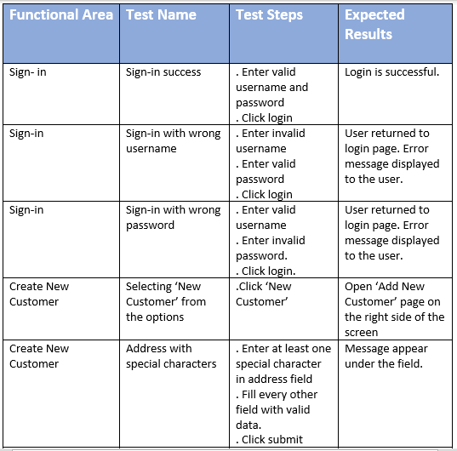
Develop test scripts for online test and test run for batch test according to test plan

Slide 17
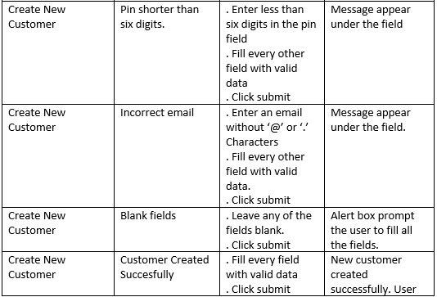
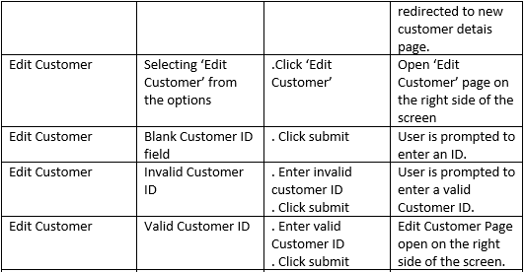

Slide 18
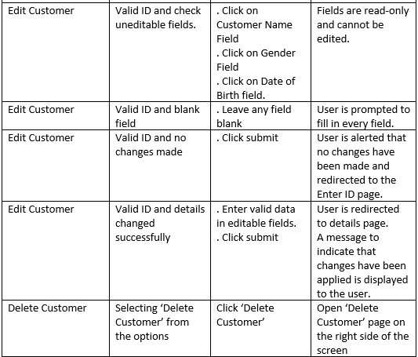
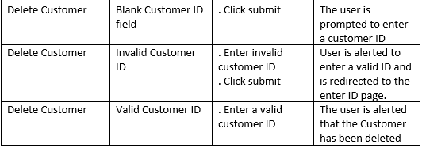

Slide 19
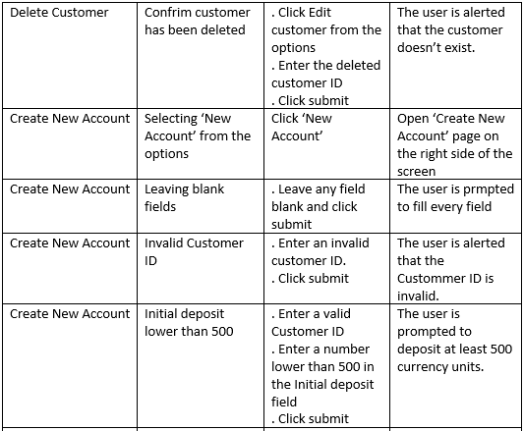
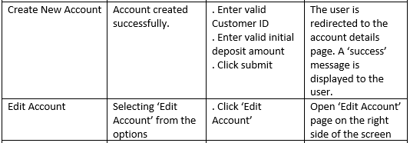

Slide 20
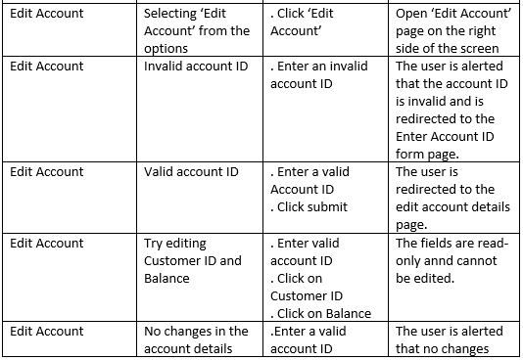
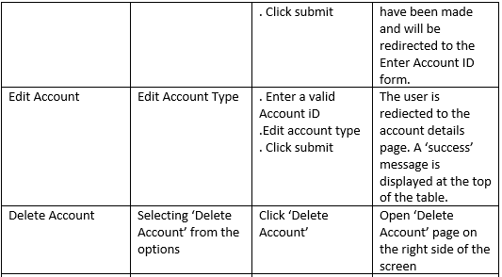

Slide 21
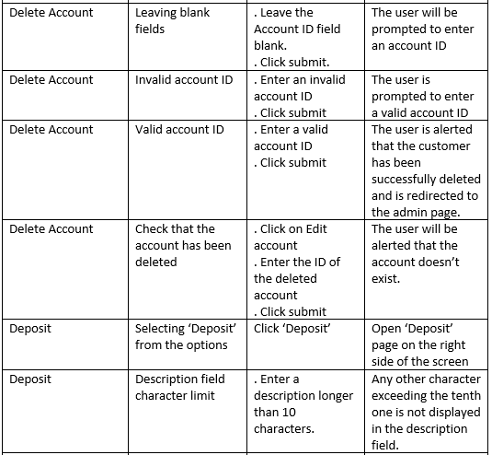
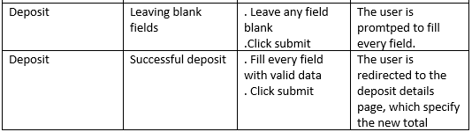

Slide 22
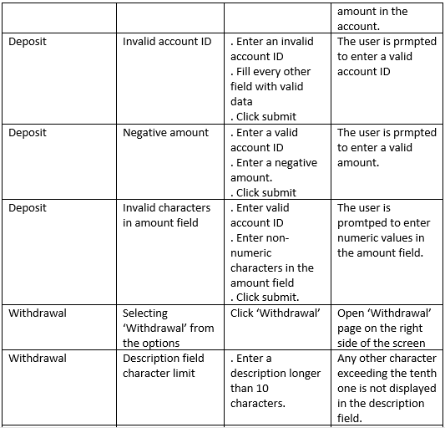
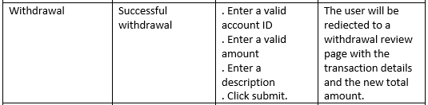

Slide 23
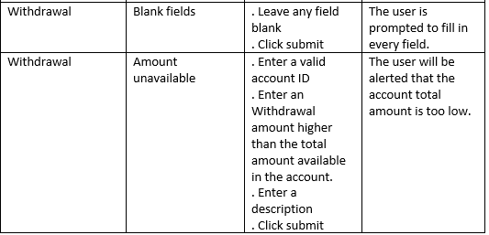
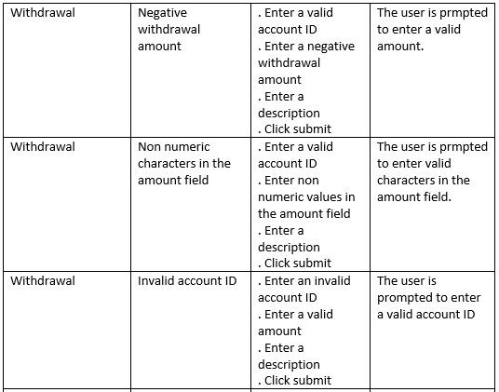

Slide 24
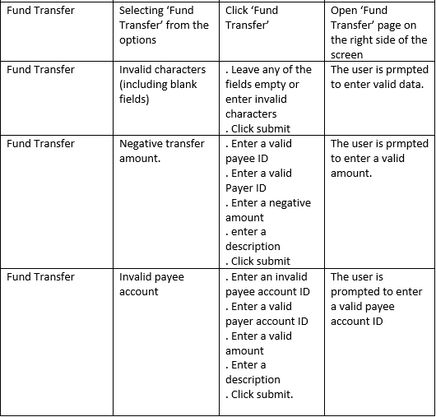
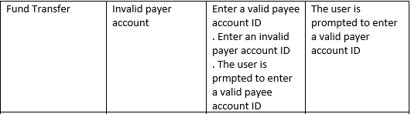

Slide 25
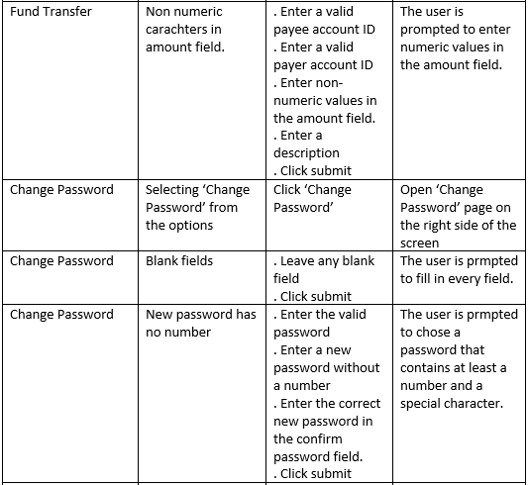
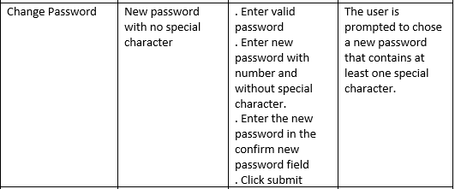

Slide 26

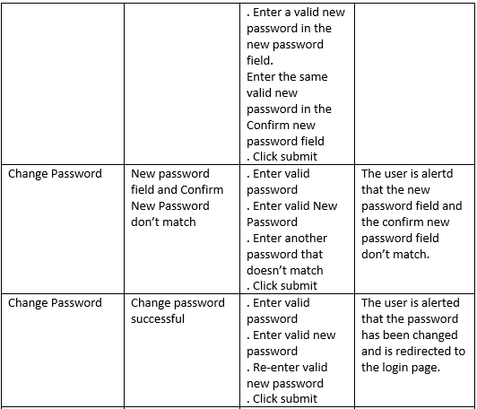


Slide 27
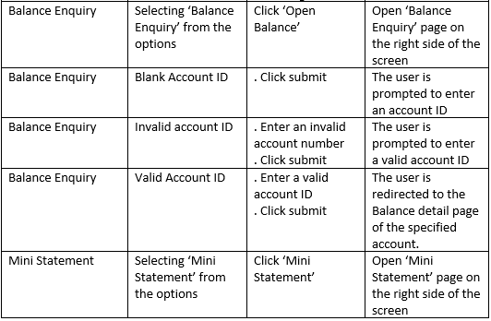
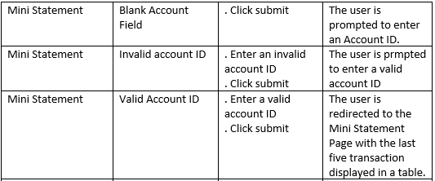

Slide 28
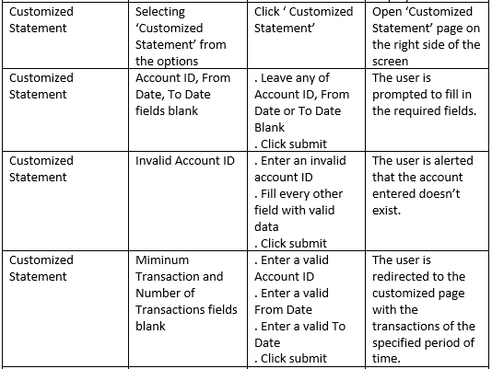
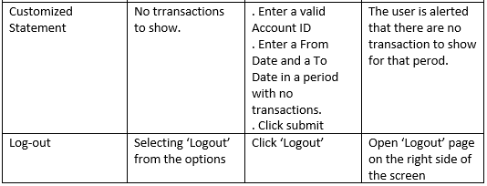

Slide 29
1.6 Prepare test environment and select test tools according to test plan
The network administrator will be notified of the test.
The colleagues will be notified of the test.
The test will take place during “quiet time” to avoid interfering with the website normal operations.
The website will be tested using a machine running Windows 10.
The website will be tested using two different browser: Chrome and Edge.
Testing tool used will be Zephyr.

Slide 30
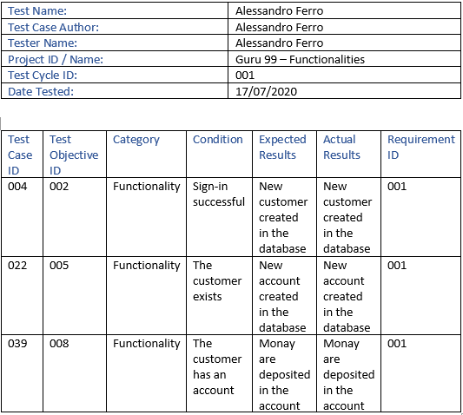
1.7 Prepare test logs and result sheets according to test plan

Slide 31
1.8 Conduct walk-through with superior to review expected results against acceptance criteria and incorporate feedback
Prepare booklet with screens and tasks for the supervisor.
Present screens one at a time
For each screen, ask the supervisor what actions would be expected to be taken.
The supervisor take notes on the provided booklet
For each screen the supervisor provides comments about any issue that may be found.
The comments are logged down.
The supervisor is told what action has been taken on the screen.
The next screen is presented to the supervisor.

Slide 32
2.1 Create clean test environment and initialise test environment according to test plan
Use a fresh browser profile
Ensure that the new profile doesn’t inherit any browser settings or extension
Close any other tab, processes or application running in the background
Disable any Dynamic CPU overclocking
Use a copy of the database.

Slide 33
2.2 Run test scripts and document results according to organisational testing and acceptance processes and test plan
Use a clean testing environment
Fill in the test log with the test details
Identify the test data or create them if needed
Check if any previous condition has been respected for the test to be run
Run test following the instruction of the test script
Check the actual results of the test against the expected results as documented in the test script
Fill in the test sheet with details about the test, its execution and the results
Execute every test in the test scripts.

Slide 34
2.3 Finalise test environment and document completed tests according to test plan and test logs and result sheets.
Creation of a test summary report to summarize the results of the tests and to highlight defects or anomalies.
The test environment is returned to its original state (clean test environment)
The test infrastructure is archived and the test data are refreshed for future testing.
The test summary is reviewed and handed over to the management.

Slide 35
2.4 Compare and document actual results to expected results for each system unit and complete result sheets
Actual results are checked against expected results to identify bugs and anomalies.
The testing sheets are filled in for each test.
A test report is produced to summarise the testing effort and result of the testing process
Defects can be either solved or left according to the company’s strategy and priorities.
The entire operation is reviewed and the lessons learned are evaluated and recorded.

Slide 36
3.1 Analyse test results against acceptance criteria to identify variances
Tests performed and relative test results should be noted down in written form.
The large amount of data resulting from testing, should be condensed in a test report.
The report should contain all the failed tests, organised by severity and urgency. Failed tests may have a follow up action included in the report as well, if deemed necessary. They can also have priority orders.
To prioritise an issue it should be considered if it’s critical or not critical for the operativity of the website as well as if its priority level is high or low.

Slide 37
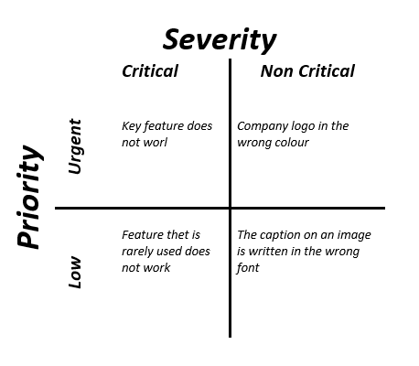

Slide 38
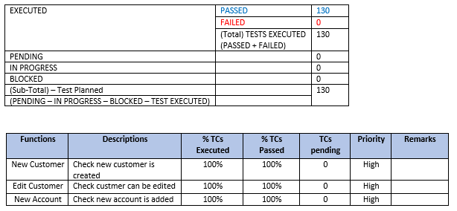
3.2 Summarise and classify test results to prepare report highlighting critical and urgent variances
When filling in a test report form is important to do by always referencing the test plan. Some tests may be made to fail by design.
All acceptance criteria need to be met.
If some functionalities have not be implemented in the test plan, they should always be highlighted, with an explanation for the omission.

Slide 39
3.3 Notify contact in operations of test completion to communicate implications
Network administrator and network operations should always be notified of the testing taking place.
Letting the contacts in operation know about the testing is vital for to reasons:
1. It doesn’t disrupt their work.
2. It allows the tester to conduct the tests (certain configurations may be needed).
Some test may require hardware temporarily loaned from operations. This hardware must be returned once the tests have ended.

Slide 40
3.4 Obtain and incorporate feedback from superior on test results report to finalise report
In some instances, testers might be required to sign a non-disclosure agreement.
Once the test report is ready, a review meeting should be organised with all the key stakeholders to discuss the results of the testing.
The meeting will include representatives from the development team, the testing team and management. Optionally it can also include client representative and sales and marketing.
Client involvement is particularly important when the development followed an agile or agile-like methodology, or other methodology that require constant feedback and collaboration with the client.
The goal of the meeting Is to review the findings of the testing team. Outstanding issues and potential actions should be discussed.

Slide 41
A plan for fixing the issues and re-testing should be defined in the meeting if considered necessary.
If in the meeting a consensus is reached and the testing (and therefore the website) are considered finished, management can be informed, so they can reach to the client for approval and sign-off.

